Slide 1
Managing Technical Debt with SonarQube

Slide 2

Richard Fennell
richardfennell
blogs.blackmarble.co.uk
black-marble
Engineering Director
Microsoft MVP (ALM) ALM Ranger

Slide 3
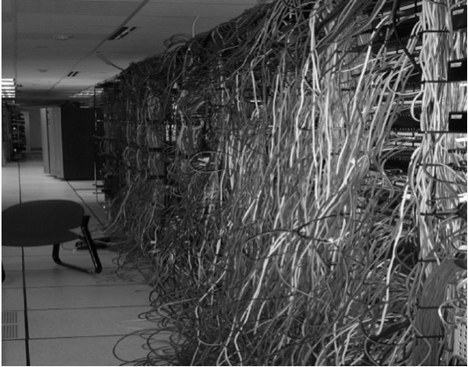
What is technical debt?
Notes:
What is technical debt
Work you put off
Initial compromises that come home to roast
That missing documentation
Tools we used
Static Analysis
Issue is that we don’t see over time

Slide 4
Technical Debt means you get less done as a code base ages
Sprint 1 – new work
Sprint 2 – new work
Debt
Sprint 3 – new work
Debt
Sprint 4 – new work
Debt
Sprint 5 – new work
Debt
Notes:
It builds up over time
It is not as if we don’t have tools to measure it
However, unless we enforce a zero level in the Microsoft space it has been hard to manage

Slide 5
What tools do we have in Microsoft land?
Compiler Errors/Warnings
FXCop/Code Analysis
StyleCop
Unit Test Coverage
Numerous other tools….
But they are snapshots in time, we need a better dashboard

Slide 6
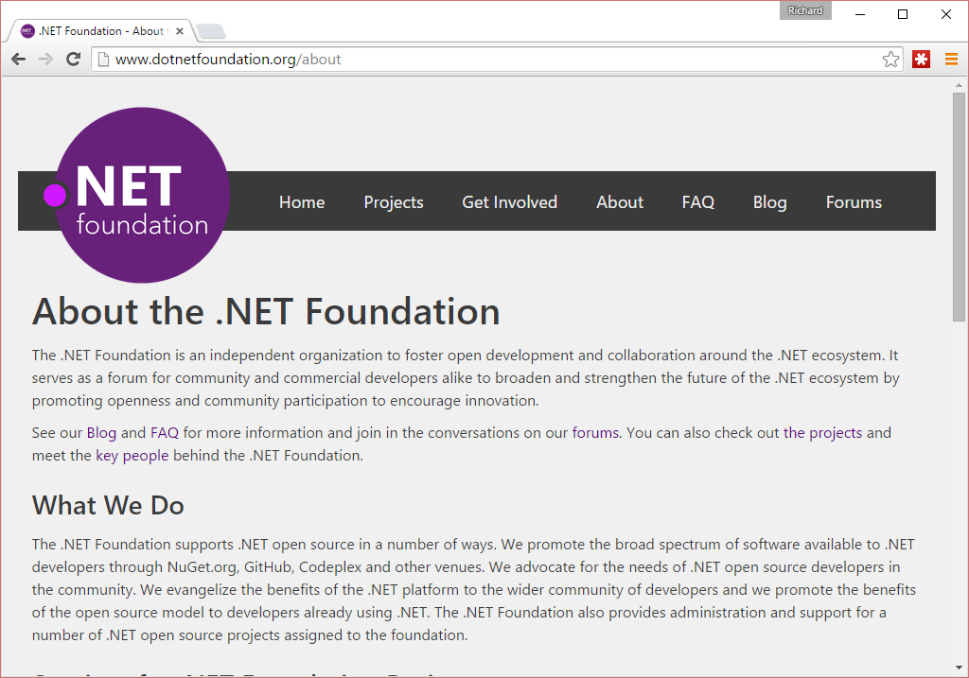
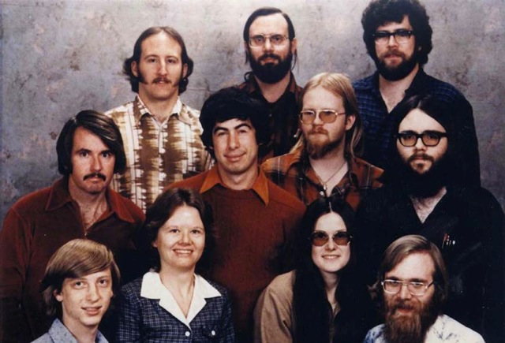
This is not your grandfather’s Microsoft
Microsoft staff in 1978
Notes:
Not your old Microsoft
Pick a market leader
Work with the team
Leverage what Roslyn can do
Provide a viable alternative to StyleCop/FxCop and more

Slide 7

Introducting SonarQube
To quote the product homepage…
“The SonarQube® platform is an open source quality management platform, dedicated to continuously analyzing and measuring the technical quality of source code, from project portfolio down to the method level. To understand what the platform tracks and why it's important, take a look at the Developers' Seven Deadly Sins.”
Notes:
Popular in the Open Source space, used to be called Sonar

Slide 8
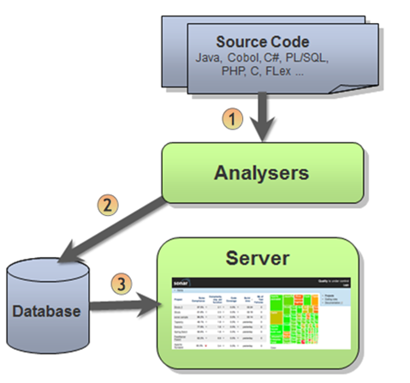
SonarQube Architecture
SonarQube Scanner Command-line Tool to analyze source code
SonarQube Scanner for Maven Integrate source code analysis to Apache Maven builds
SonarQube Scanner for MSBuild Integrate source code analysis to any .Net projects
SonarQube Scanner for Ant Integrate source code analysis to Apache Ant builds
Notes:
Currently the runner needs access to DB

Slide 9
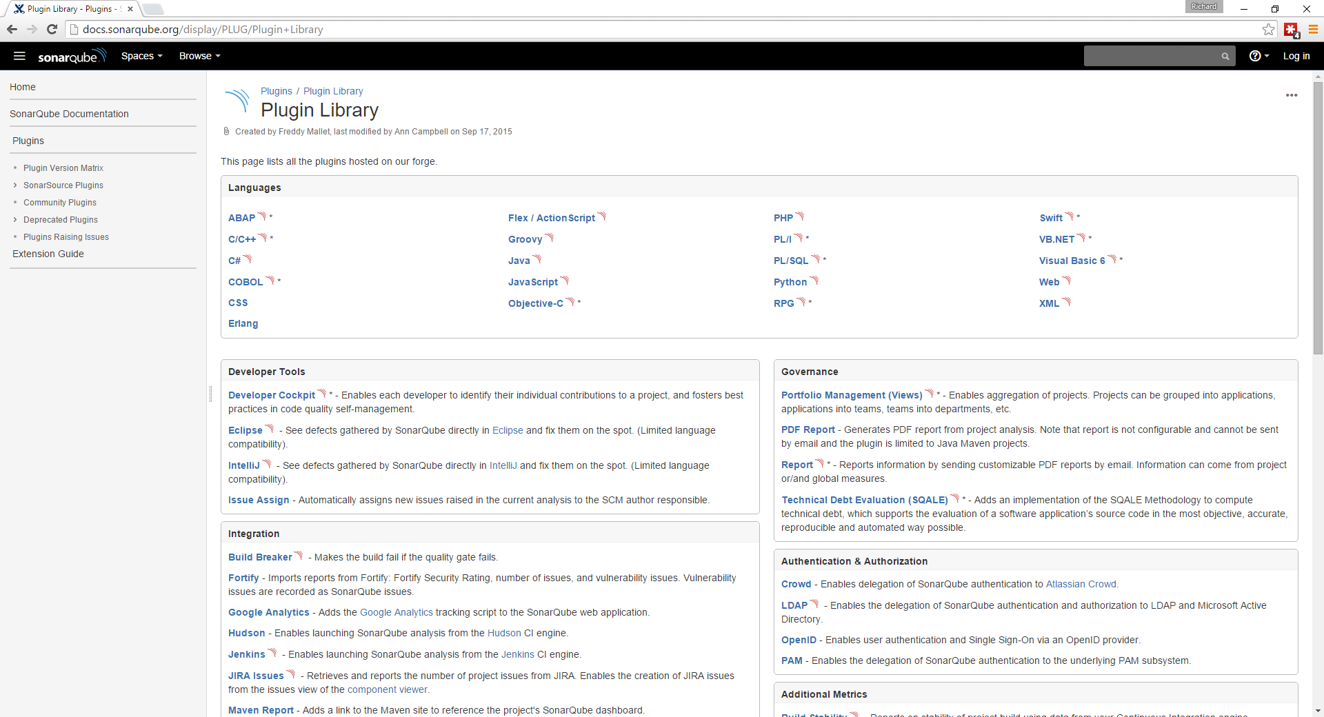

Slide 10
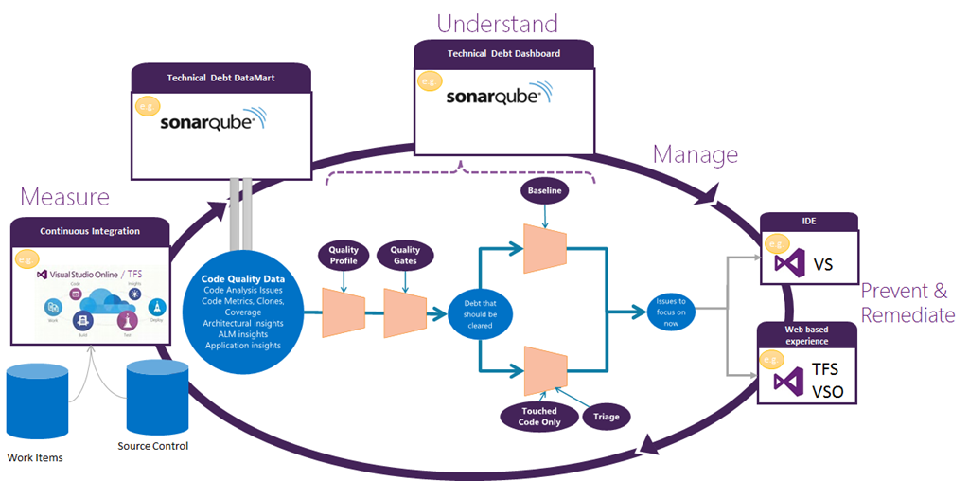
Notes:
How Microsoft see it fitting in

Slide 11
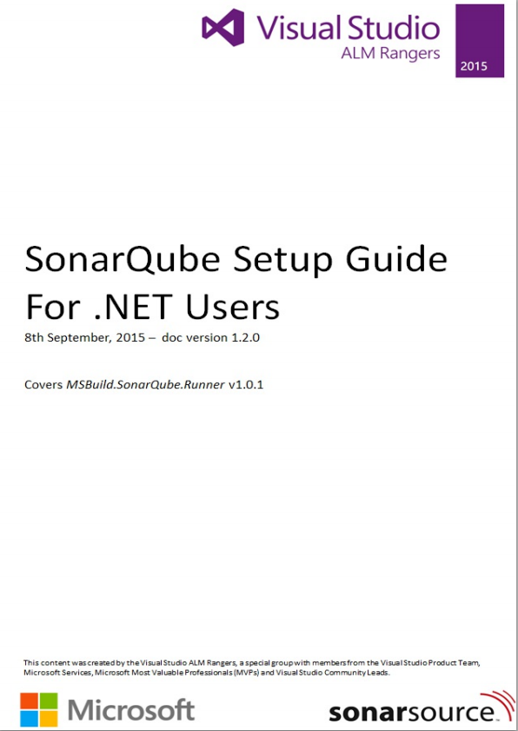
Setup of SonarQube
Has a few gotcha’s so
See the ALM Rangers Guide
https://github.com/SonarSource/sonar-.net-documentation
Also see SonarQube site
http://docs.sonarqube.org/display/SONAR/ Setup+and+Upgrade

Slide 12
Installation – Server Requirements
A VM
1 Gb of memory
Can be Windows or Linux
.NET 4.5.2 (for the MSBuild Runner)
Java
Oracle JRE 7 (or greater)
OpenJDK 7 (or greater)
Database
H2 (for demo only)
Microsoft SQL Server 2008 or later
Oracle 10G/11G with Oracle 11.2x drivers
MySQL 5.1 (or greater)
Web Browser
IE 9+
And all other current browsers
Notes:
Remember you need a Java patching plan
The easiest is to use the H2 document DB, but only works if everything on done box

Slide 13
Installation – Setup Microsoft SQL
You need a real DB – but SQL Express is enough
Beware the JDBC drivers, from my experience
They are not fond of clustering
Or of integrated Windows security
DB names are case sensitive
Collation must be set to case-sensitive (CS) and accent-sensitive (AS) e.g. SQL_Latin1_General_CP1_CI_AS
Process
Create and empty DB
Create a user and grant rights as owner of the empty DB
Remember the values as they need to go in a various config files
Open port 1433 in the SQL server firewall

Slide 14
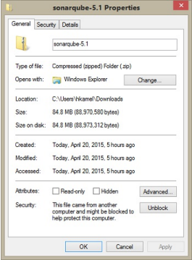
Installation – SonarQube Server
Install the JRE
Download sonarqube-5.x.zip
Make sure the ZIP is unblocked
Unzip it to a folder e.g: C:\sonarqube
Edit C:\sonarqube\conf\sonar.properties to set the connection string and authentication sonar.jdbc.username=sonaruser sonar.jdbc.password=Pass@w0rd1 sonar.jdbc.url=jdbc:jtds:sqlserver://localhost/Sonar;SelectMethod=Cursor
(There is more settings you can edit, but these should be enough)
Open port 9000 in the server firewall

Slide 15
Installation – Plug-Ins
Can be installed manual
Download the C# Plug-in from SonarQube
Make sure the ZIP is unblocked
Unzip it
Drop the JAR file in C:\sonarqube\extensions\plugins
Or via the SonarQube management UI

Slide 16
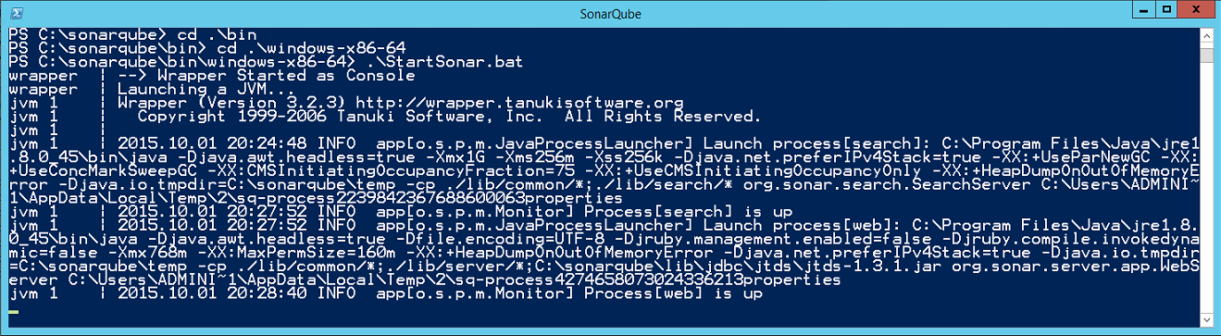
Installation – Start the Server
Use a script from C:\sonarqube\bin
Probably best to start using .\windows-x86-64\StartSonar.bat
Look in C:\sonarqube\logs if you have problems

Slide 17
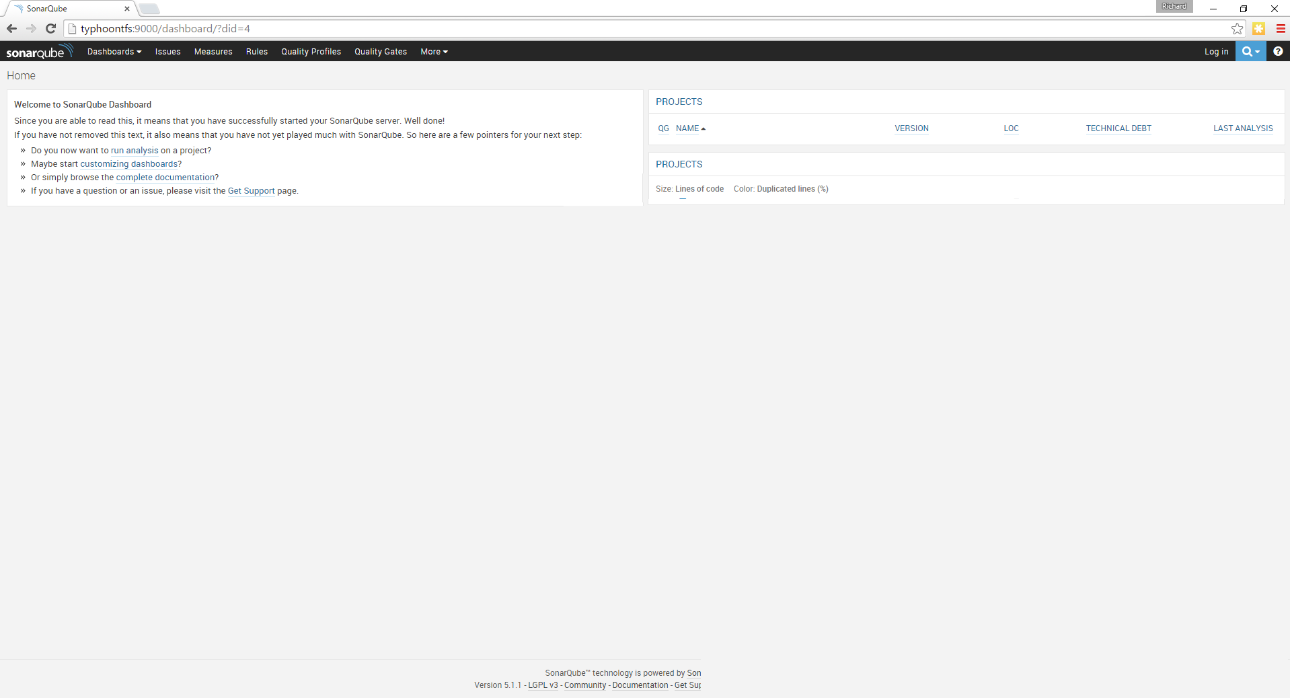
Notes:
Should see something like this

Slide 18
Install – The Sonar Runner
On a PC with the code to analyse
Download from SonarQube
http://www.sonarqube.org/downloads/
Unblock and unzip
Set the DB connection details in the .\Conf\sonar-runner.properties
Consider adding editing the Windows Path

Slide 19
Analysis from the command line
Create a sonar-project.properties in root of your project
Run the batch file sonar-runner
# must be unique in a given SonarQube instance
sonar.projectKey=my:project
# this is the name displayed in the SonarQube UI
sonar.projectName=My project
sonar.projectVersion=1.0
# Path is relative to the sonar-project.properties file. Replace "\" by "/" on Windows.
# Since SonarQube 4.2, this property is optional if sonar.modules is set.
# If not set, SonarQube starts looking for source code from the directory containing
# the sonar-project.properties file.
sonar.sources=.
# Encoding of the source code. Default is default system encoding
#sonar.sourceEncoding=UTF-8
http://docs.sonarqube.org/display/SONAR/Analyzing+with+SonarQube+Runner

Slide 20
Run as part of a Build
Option 1
Just use the same command line script
Option 2
Use task/activity appropriate to your Build system
ANT
Maven
MSBUILD

Slide 21
Install – The MSBuild Runner
This generates the sonar-project.properties automatically
Probably need to install this on a build VM (with a JRE)
Download from SonarQube
http://www.sonarqube.org/downloads/
Unblock and unzip
Set the DB connection details in SonarQube.Analysis.xml

Slide 22
Run from the command line
You can still manually run the processing
C:\myproject>
C:\myproject>MSBuild.SonarQube.Runner.exe begin /key:{SonarQube project key} /name:{SQ project name} /version:{SQ project version}
C:\myproject>Msbuild
C:\myproject>MSBuild.SonarQube.Runner.exe end
Powershell

Slide 23
Integration with TFS Build
Option 1
Call MSBuild.SonarQube.Runner.exe via pre/post scripts
Option 2
Use a TFS build task (that does the same behind the scenes)

Slide 24
Demo
Build Automation
Notes:
Show a build running
Mention uploading a task
See process on http://realalm.com/2015/07/31/uploading-a-custom-build-vnext-task/
Install npm/gulp
Clone the repo https://github.com/Microsoft/vso-agent-tasks
Run gulp
Look in the _build folder
Use https://www.npmjs.com/package/tfx-cli to upload – remember needs basic auth and full TPC name
tfx login --authtype basic
tfx build tasks upload --taskpath .\_build\Tasks\SonarQubePostTest\
tfx build tasks upload --taskpath .\_build\Tasks\SonarQubePreTest\
Add the tasks to the build
Provide the sonarqube server
If < SonarQube 5.2 need to provide the Db connection strings

Slide 25
So what do I see in SonarQube?
Dashboards
Tables and Charts
Trends over time
Base-lines based on version
Technical Debt time estimates
Quality Ratings
Quality Gates

Slide 26
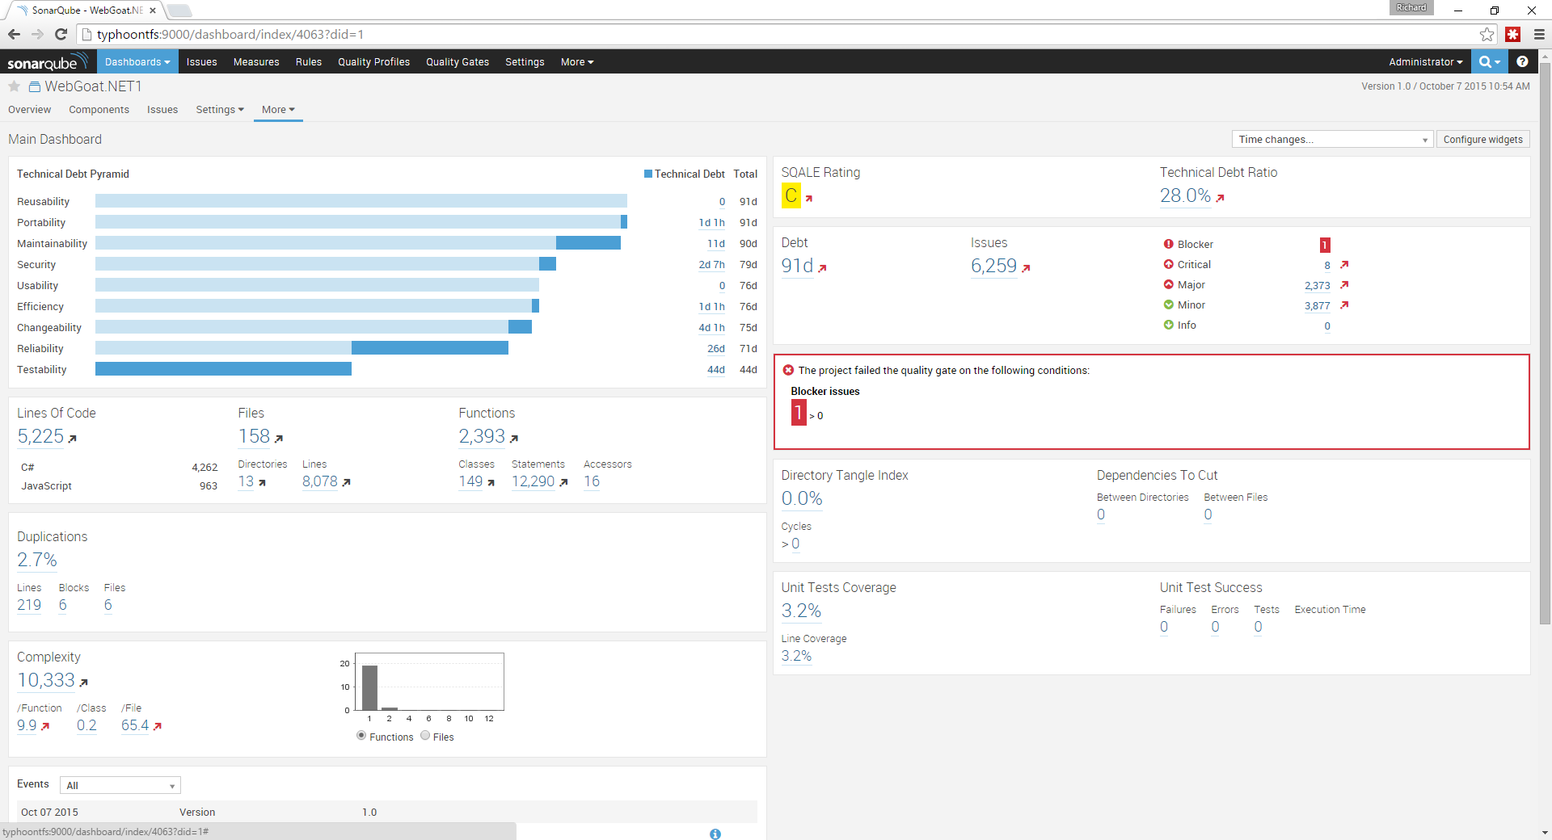

Slide 27
Demo
SonarQube Dashboards
Notes:
Mention gotcha’s
Not all the features are wired up yet
The excludes are folder based, so work splitting 3rd party libraries from your own code – might be hard with nuget?
Work through
Rules
Quality Profiles
Quality Gate
Time machines
Set issue ownership

Slide 28
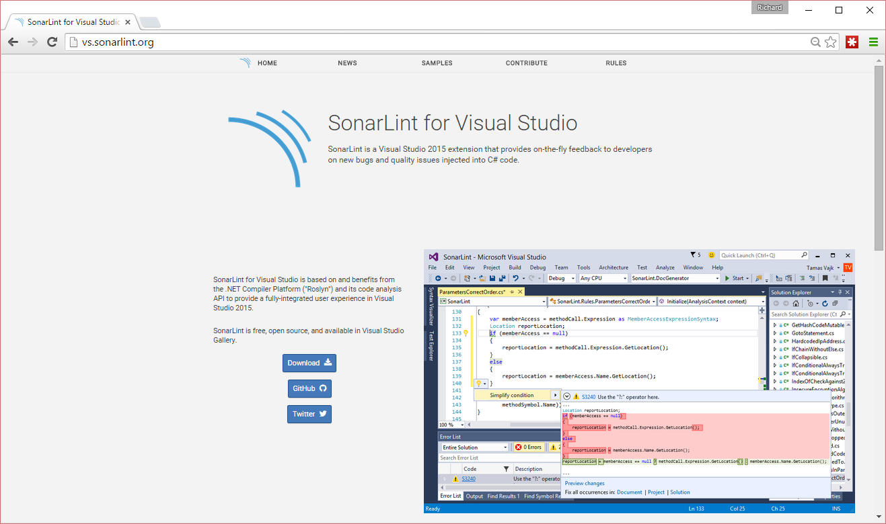

Slide 29
Future of Microsoft & SonarQube
Enhancing the interaction, including
‘In the box’ on-prem in TFS 2015 Update 1 (but you can set it up now)
Seamless Active Directory Integration
One-click install of SonarQube
SonarQube Widget on VSO/TFS
TFVC support (Code ownership etc.)
Issue filtering to prevent "warning fatigue"
Pull requests integration
http://blogs.msdn.com/b/visualstudioalm/archive/2015/09/23/sonarqube-integration-plans.aspx

Slide 30
Resources
SonarQube
http://www.sonarqube.org/
Microsoft Product Team on Technical Debt
http://blogs.msdn.com/b/visualstudioalm/archive/tags/managing+technical+debt/
ALM Rangers Guide on SonarQube
https://github.com/SonarSource/sonar-.net-documentation http://blogs.msdn.com/b/visualstudioalmrangers/archive/tags/vsartechnicaldebt/
SonarLint
http://vs.sonarlint.org/
Find these slides
https://github.com/rfennell/Presentations

Slide 31
Contact
richard@blackmarble.com
@richardfennell
http://blogs.blackmarble.co.uk/blogs/rfennell

